Slide 1
Revision Activity 1:
For each department: HR, Finance, Marketing, Operations.
Discuss IS support. Output: Poster or short slide.

Slide 2
Revision Activity 2:
Case Summary:
Kenya Revenue Authority moved from manual tax to digital iTax platform.
Discussion Questions:
- What challenges do you think KRA faced in moving from manual to digital?
- How did MIS improve revenue collection?

Slide 3
Business Processes and Information Systems
Business processes refer to the manner in which work is organized, coordinated, and focused to produce a valuable product or service.
Business processes also refer to the unique ways in which organizations coordinate work, information, and knowledge, and the ways in which management chooses to coordinate work.
Every business can be seen as a collection of business processes.
To a large extent, the performance of a business firm depends on how well its business processes are designed and coordinated.
Many business processes are tied to a specific functional area, such as sales and marketing, while others cross many different functional areas and require coordination across departments.

Slide 4
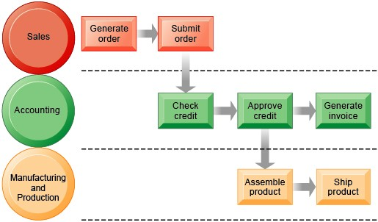
FIGURE 2-1 THE ORDER FULFILLMENT PROCESS
Fulfilling a customer order involves a complex set of steps that requires the close coordination of the sales, accounting, and manufacturing functions.
Information systems enhance business processes in primarily two ways:
(1)Increasing the efficiency of existing processes
(2)Enabling entirely new processes that are capable of transforming the business

Slide 5
Types of Business Information Systems
No single system can provide all the information an organization needs. Even small firms have a collection of different systems: e-mail systems, sales tracking systems, etc. Different systems can be described through:
A functional perspective: Identifying systems by their major business function.
A constituency perspective: Identifying systems in terms of the major organizational groups that they serve
There are four main types of information systems that serve different functional systems:
1) Sales and marketing information systems help the firm with marketing business processes (identifying customers for the firm's products or services, developing products and services to meet their needs, promoting products and services) and sales processes (selling the products and services, taking orders, contacting customers, and providing customer support).

Slide 6
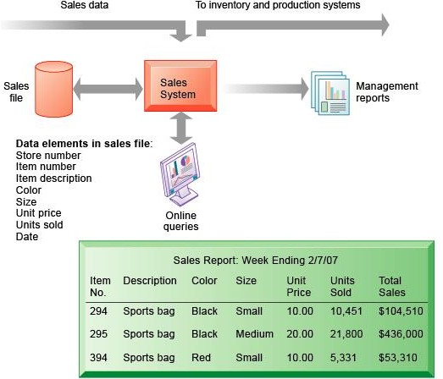
FIGURE 2-2 EXAMPLE OF A SALES INFORMATION SYSTEM
This system captures sales data at the moment the sale takes place to help the business monitor sales transactions and to provide information to help management analyze sales trends and the effectiveness of marketing campaigns.

Slide 7
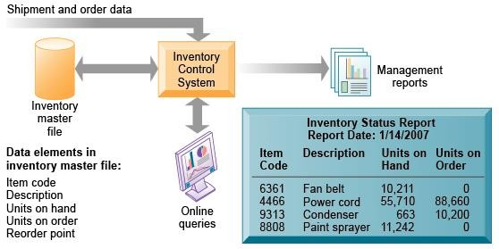
  2) Manufacturing and production information systems deal with the planning, development, and production of products and services, and controlling the flow of production.

Slide 8
FIGURE 2-3 OVERVIEW OF AN INVENTORY SYSTEM
This system provides information about the number of items available in inventory to support manufacturing and production activities.

Slide 9
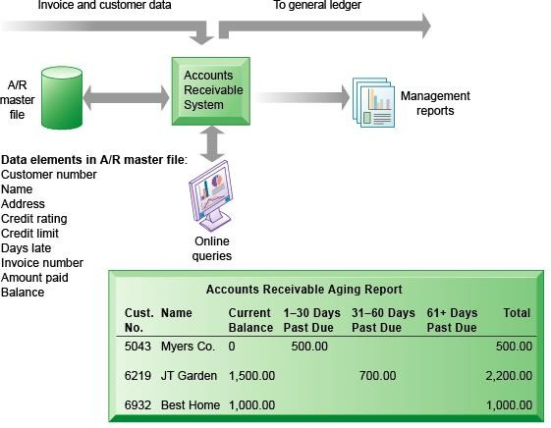
3) Finance and accounting information systems keep track of the firm's financial assets and fund flows.

Slide 10
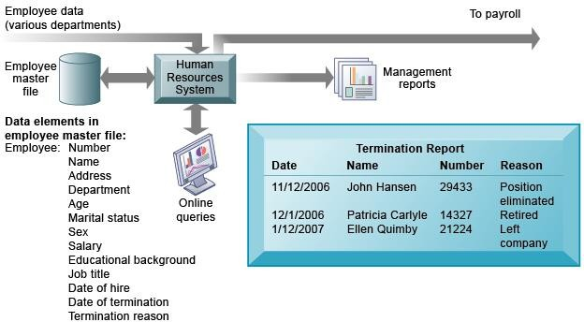
  4) Human resources information systems maintain employee records, track employee skills, job performance and training, and support planning for employee compensation and career development. Figure 2-5 below

Slide 11
There are four main categories of systems from a constituency perspective
1) Transaction processing systems (TPS) are basic business systems that serve the operational level of the organization by recording the daily routine transactions required to conduct business, such as payroll and sales receipts.
2) Management information systems (MIS) serve middle managers' interests by providing current and historical performance information to aid in planning, controlling, and decision making at the management level. MIS typically compress TPS data to present regular reports on the company's basic operations.

Slide 12
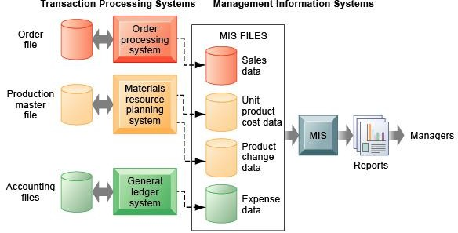
FIGURE 2-6 HOW MANAGEMENT INFORMATION SYSTEMS OBTAIN THEIR DATA FROM THE ORGANIZATION’S TPS

Slide 13
In the system illustrated by this diagram, three TPS supply summarized transaction data to the MIS reporting system at the end of the time period. Managers gain access to the organizational data through the MIS, which provides them with the appropriate reports.
3) Decision support systems (DSS), or business intelligence systems, help managers with non- routine decisions that are unique, rapidly changing, and not easily specified in advance. DSS are more analytical than MIS, using a variety of models to analyze internal and external data or condense large amounts of data for analysis.

Slide 14
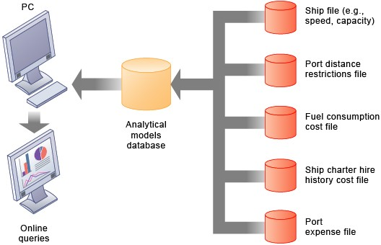
FIGURE 2-8 VOYAGE-ESTIMATING DECISION-SUPPORT SYSTEM

Slide 15
4) Executive support systems (ESS) provide a generalized computing and communications environment that help senior managers address strategic issues and identify long-term trends in the firm and its environment.
ESS address non routine decisions requiring judgment, evaluation, and insight because there is no agreed-on procedure for arriving at a solution.
ESS present graphs and data from many internal and external sources through an interface that is easy for senior managers to use.
Often the information is delivered to senior executives through a portal, which uses a Web interface to present integrated personalized business content.

Slide 16
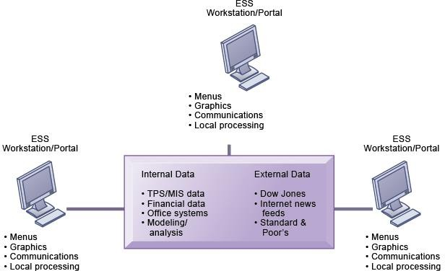
FIGURE 2-9 MODEL OF AN EXECUTIVE SUPPORT SYSTEM
This system pools data from diverse internal and external sources and makes them available to executives in an easy-to-use form.

Slide 17
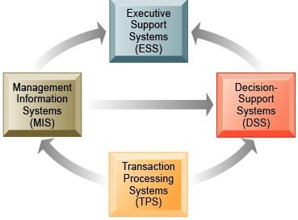
Ideally, these constituency-based systems are interrelated. TPS are typically a major source of data for other systems, whereas ESS are primarily a recipient of data from lower-level systems and external sources.
Figure 2-10 below.

Slide 18
The various types of systems in the organization have interdependencies.
TPS are major producers of information that is required by many other systems in the firm, which, in turn, produce information for other systems.
These different types of systems are loosely coupled in most business firms, but increasingly firms are using new technologies to integrate information that resides in many different systems.

Slide 19
Systems that Span the Enterprise
Enterprise applications are systems that span functional areas, focus on executing business processes across the business firm, and include all levels of management.
Enterprise applications help businesses become more flexible and productive by coordinating their business processes more closely. There are four major enterprise applications:
      Enterprise systems
      Supply chain management systems
      Customer relationship management systems
      Knowledge management systems
Each of these enterprise applications integrates a related set of functions and business processes to enhance the performance of the organization as a whole.

Slide 20
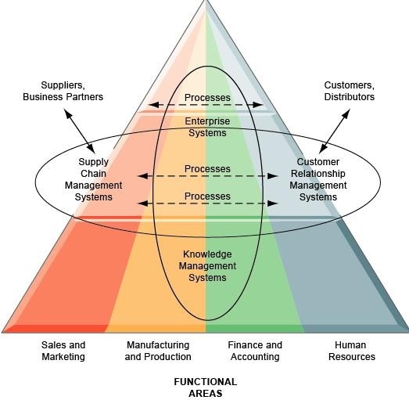
FIGURE 2-11 ENTERPRISE APPLICATION ARCHITECTURE
Enterprise applications automate processes that span multiple business functions and organizational levels and may extend outside the organization.

Slide 21
Enterprise systems, or Enterprise Resource Planning (ERP) systems
Enterprise systems, or enterprise resource planning (ERP) systems, model and automate many business processes, such as filling an order or scheduling a shipment, with the goal of integrating information across the entire company and eliminating complex, expensive links between computer systems in different areas of the business. Information that was previously fragmented in different systems can seamlessly flow throughout the organization so that it can be shared by business processes in manufacturing, accounting, human resources, and other areas of the firm.
Discrete business processes from sales, production, finance, and logistics can be integrated into company-wide business processes that flow across organizational levels and functions.
The enterprise system collects data from various key business processes and stores the data in a single comprehensive data repository where they can be used by other parts of the business. Managers emerge with more precise and timely information for coordinating the daily operations of the business and a firm-wide view of business processes and information flows.

Slide 22
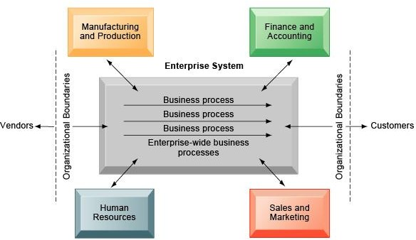
FIGURE 2-12 ENTERPRISE SYSTEMS
Enterprise systems integrate the key business processes of an entire firm into a single software system that enables information to flow seamlessly throughout the organization. These systems focus primarily on internal processes but may include transactions with customers and vendors.

Slide 23
Supply chain management (SCM) systems
Supply chain management (SCM) systems help businesses manage relationships with their suppliers. These systems provide information to help suppliers, purchasing firms, distributors, and logistics companies share information about orders, production, inventory levels, and delivery of products and services so that they can source, produce, and deliver goods and services efficiently.
SCM systems increase firm profitability by lowering the costs of moving and making products and by enabling managers to make better decisions about how to organize and schedule sourcing, production, and distribution. Supply chain management systems are one type of interorganizational system because they automate the flow of information across organizational boundaries.
Firms that skillfully manage their supply chains get the right amount of products from their source to point of consumption with the least amount of time and the lowest cost. Figure 2-13 below
Customer orders, shipping notifications, optimized shipping plans, and other supply chain information flow among Haworth’s Warehouse Management System (WMS), Transportation Management System (TMS), and its back-end corporate systems.

Slide 24
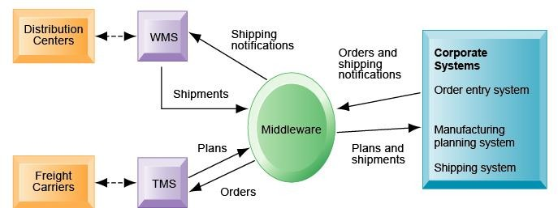
FIGURE 2-13 EXAMPLE OF A SUPPLY CHAIN MANAGEMENT SYSTEM
Customer orders, shipping notifications, optimized shipping plans, and other supply chain information flow among Haworth’s Warehouse Management System (WMS), Transportation Management System (TMS), and its back-end corporate systems.

Slide 25
Customer relationship management (CRM) systems
Customer relationship management (CRM) systems focus on coordinating the business processes surrounding a firm's interactions with its customers in sales, marketing, and service to optimize revenue, customer satisfaction, and customer retention.
They consolidate customer data from multiple sources and communication channels to help firms identify profitable customers, acquire new customers, improve service and support, and target products and services more precisely to customer preferences.
The value of a firm's products and services is based not only on its physical resources but also on intangible knowledge assets. Some firms perform better than others because they have better knowledge about how to create, produce, and deliver products and services.

Slide 26
Knowledge management systems
Knowledge management systems support processes for discovering and codifying, sharing, and distributing knowledge, as well as processes for creating new knowledge and integrating external sources of knowledge.
Companies that do not have the resources to invest in enterprise applications can still achieve some measure of information integration by using intranets and extranets.
Intranets typically present information to employees through a private portal that provides a single point of access to information from several different systems and to documents using a Web interface.
Corporate portals often feature e-mail, collaboration tools, and tools for searching for internal corporate systems and documents. Companies can connect their intranets to internal company transaction systems, enabling employees to take actions central to a company's operations, such as checking the status of an order or granting a customer credit.

Slide 27
Extranets expedite the flow of information between the firm and its suppliers and customers. They can allow different firms to work collaboratively on product design, marketing, and production.
Enterprise applications and technologies are transforming firms' relationships with customers, employees, suppliers, and logistic partners into digital relationships using networks and the Internet.
Electronic business, or e-business, refers to the use of digital technology and the Internet to execute the major business processes in the enterprise.
E-business includes activities for the internal management of the firm and for coordination with suppliers and other business partners. It also includes electronic commerce, or e-commerce. E-commerce is the part of e-business that deals with the buying and selling of goods and services over the Internet. It encompasses activities supporting those market transactions, such as advertising, marketing, customer support, security, delivery, and payment.

Slide 28
E-government refers to the application of the Internet and networking technologies to digitally enable government and public sector agencies' relationships with citizens, businesses, and other arms of government. In addition to improving delivery of government services, e-government can make government operations more efficient and also empower citizens by giving them easier access to information.
The Information Systems Function in Business
In all but the smallest of firms, the information systems department is the formal organizational unit responsible for information technology services.
The information systems department is responsible for maintaining the hardware, software, data storage, and networks that comprise the firm's IT infrastructure.
The information systems department suggests new business strategies and new information-based products and services, and coordinates both the development of the technology and the planned changes in the organization. The information systems department consists of specialists, such as:

Slide 29
Programmers: technical specialists who write the software instructions for computers
Systems analysts: the principal liaisons between the information systems groups and the rest of the organization.
Information systems managers: leaders of teams of programmers and analysts, project managers, physical facility managers, telecommunications managers, or database specialists
In many companies, the information systems department is headed by a chief information officer (CIO), a senior manager who oversees the use of information technology in the firm.
End users are representatives of departments outside of the information systems group for whom applications are developed.
Small companies may not have a formal information systems group.
Larger companies will have a separate information systems department, which may be organized along several different lines, depending on the nature and interests of the firm, such as:
Decentralized arrangement: Each functional area of the business has its own information systems department and management that typically reports to a senior manager or chief information officer.
Separate department: In this arrangement, the information systems function operates as a separate department similar to the other functional departments with a large staff, a group of middle managers, and a senior management group.
Divisional groups: Very large "Fortune 1,000"-size firms with multiple divisions and product lines might allow each division (such as the Consumer Products Division or the Chemicals and Additives Division) to have its own information systems group. All of these divisional information systems groups report to a high-level central information systems group and CIO.

